Slide 1


Slide 2
Announcements

Slide 3
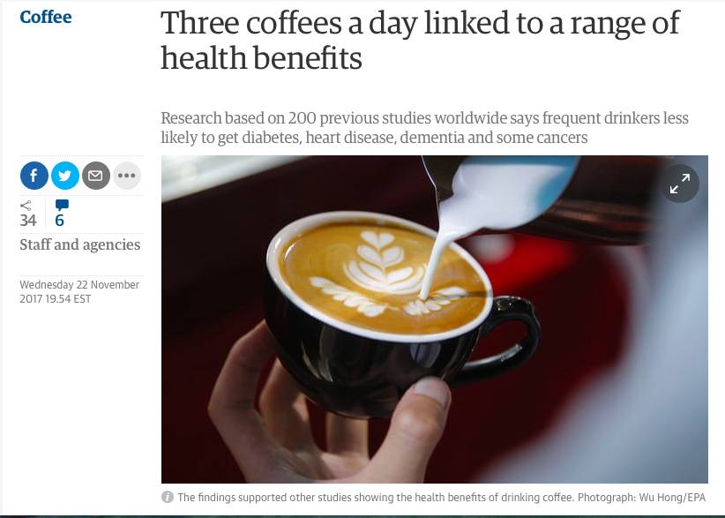
A Link
Guardian UK

Slide 4

A Stronger Link?
npr.org (report on a study in heart.bmj.com)

Slide 5
Observation
individuals, study subjects, participants, units
European adults
treatment
chocolate consumption
outcome
heart disease

Slide 6
The first question
Is there any relation between chocolate consumption and heart disease?
association
any relation
link

Slide 7
An answer
Some data:
“Among those in the top tier of chocolate consumption, 12 percent developed or died of cardiovascular disease during the study, compared to 17.4 percent of those who didn’t eat chocolate.” - Howard LeWine of Harvard Health Blog, reported by npr.org
Does this point to an association?

Slide 8
The next question
Does chocolate consumption lead to a reduction in heart disease?
causality
This question is often harder to answer.
“[The study] doesn’t prove a cause-and-effect relationship between chocolate and reduced risk of heart disease and stroke.” - JoAnn Manson, chief of Preventive Medicine at Brigham and Women’s Hospital, Boston

Slide 9
Association

Slide 10
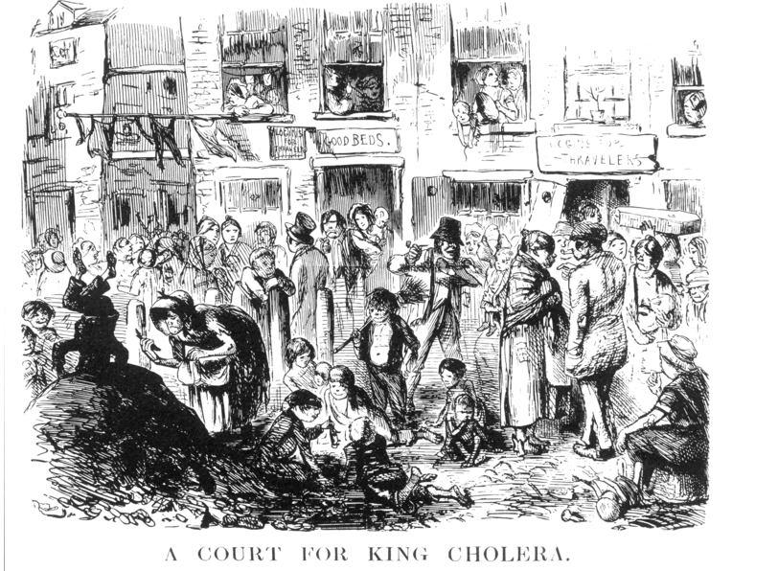
London, early 1850’s
Illustration from Punch (1852).
Notes:
One of the most powerful examples of astute observation eventually leading to the establishment of causality dates back more than 150 years.
To get your mind into the right timeframe, try to imagine London in the 1850’s. It was the world’s wealthiest city but many of its people were desperately poor.
Charles Dickens, then at the height of his fame, was writing about their plight.
Disease was rife in the poorer parts of the city, and cholera was among the most feared.
It was not yet known that germs cause disease; the leading theory was that “miasmas” were the main culprit.
Miasmas manifested themselves as bad smells, and were thought to be invisible poisonous particles arising out of decaying matter.
Parts of London did smell very bad, especially in hot weather. To protect themselves against infection, those who could afford to held sweet-smelling things to their noses.

Slide 11
Miasmas, miasmatism, miasmatists
Bad smells given off by waste and rotting matter
Believed to be the main source of disease
Suggested remedies:
“fly to clene air”
“a pocket full o’posies”
“fire off barrels of gunpowder”
Staunch believers:
Florence Nightingale (founder of modern nursing)
Edwin Chadwick (Commissioner of the General Board of Health)
Notes:
Staunch Believer: If you are a great believer in something, you think that it is good, right, or useful

Slide 12
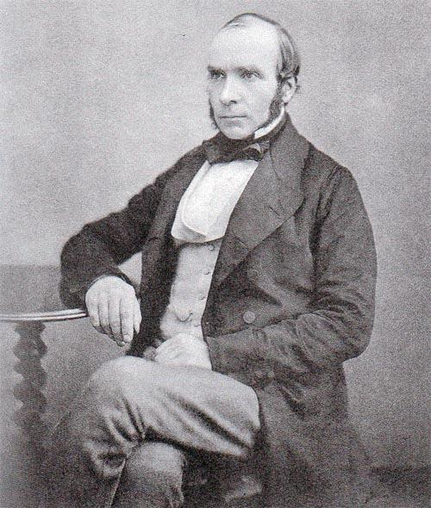
John Snow, 1813-1858
Notes:
For several years, a doctor by the name of John Snow had been following the devastating waves of cholera that hit England from time to time.
The disease arrived suddenly and was almost immediately deadly:
people died within a day or two of contracting it, hundreds could die in a week, and the total death toll in a single wave could reach tens of thousands.
Snow was skeptical of the miasma theory. He had noticed that while entire households were wiped out by cholera, the people in neighboring houses sometimes remained completely unaffected.
As they were breathing the same air—and miasmas—as their neighbors, there was no compelling association between bad smells and the incidence of cholera.
Snow had also noticed that the onset of the disease almost always involved vomiting and diarrhea.
He therefore believed that the infection was carried by something people ate or drank, not by the air that they breathed. His prime suspect was water contaminated by sewage.

Slide 13
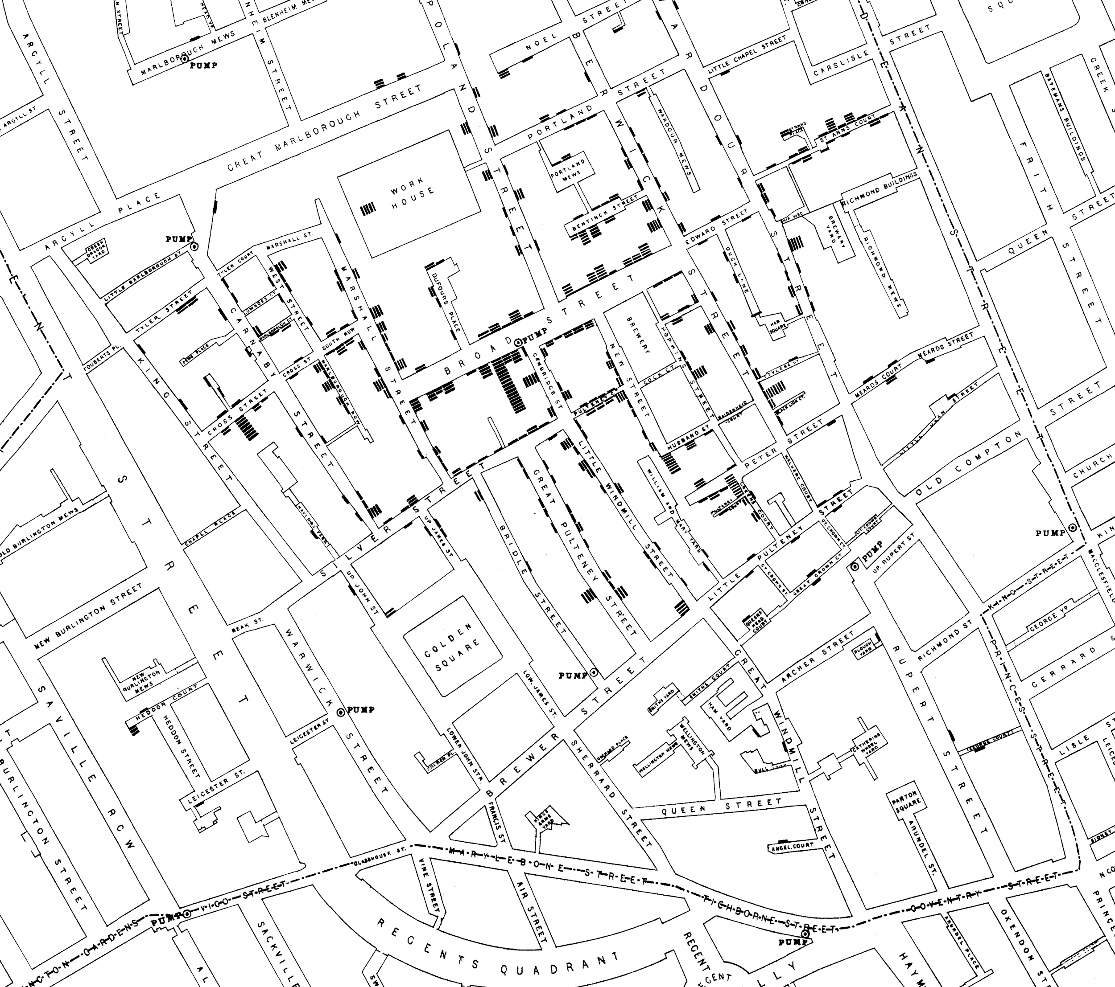
Notes:
At the end of August 1854, cholera struck in the overcrowded Soho district of London.
As the deaths mounted, Snow recorded them diligently, using a method that went on to become standard in the study of how diseases spread: he drew a map. On a street map of the district, he recorded the location of each death.
Here is Snow’s original map.
Each black bar represents one death.
When there are multiple deaths at the same address, the bars corresponding to those deaths are stacked on top of each other.
The black discs mark the locations of water pumps.
The map displays a striking revelation—the deaths are roughly clustered around the Broad Street pump.

Slide 14
Notes:
Snow studied his map carefully and investigated the apparent anomalies. All of them implicated the Broad Street pump. For example:
There were deaths in houses that were nearer the Rupert Street pump than the Broad Street pump. Though the Rupert Street pump was closer as the crow flies, it was less convenient to get to because of dead ends and the layout of the streets. The residents in those houses used the Broad Street pump instead.
There were no deaths in two blocks just east of the pump. That was the location of the Lion Brewery, where the workers drank what they brewed. If they wanted water, the brewery had its own well.
There were scattered deaths in houses several blocks away from the Broad Street pump. Those were children who drank from the Broad Street pump on their way to school. The pump’s water was known to be cool and refreshing.
The final piece of evidence in support of Snow’s theory was provided by two isolated deaths in the leafy and genteel Hampstead area, quite far from Soho.
Snow was puzzled by these until he learned that the deceased were Mrs. Susannah Eley, who had once lived in Broad Street, and her niece. Mrs. Eley had water from the Broad Street pump delivered to her in Hampstead every day. She liked its taste.

Slide 15
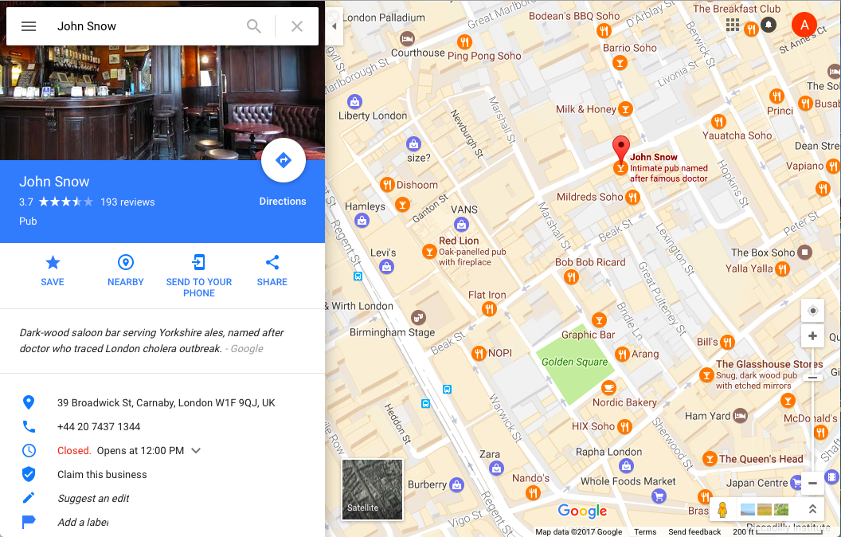
Notes:
Later it was discovered that a cesspit that was just a few feet away from the well of the Broad Street pump had been leaking into the well.
Thus the pump’s water was contaminated by sewage from the houses of cholera victims.

Slide 16

Notes:
Snow used his map to convince local authorities to remove the handle of the Broad Street pump.
Though the cholera epidemic was already on the wane when he did so, it is possible that the disabling of the pump prevented many deaths from future waves of the disease.
The removal of the Broad Street pump handle has become the stuff of legend.
At the Centers for Disease Control (CDC) in Atlanta, when scientists look for simple answers to questions about epidemics, they sometimes ask each other, “Where is the handle to this pump?”
Snow’s map is one of the earliest and most powerful uses of data visualization. Disease maps of various kinds are now a standard tool for tracking epidemics.

Slide 17
Causation
Notes:
Though the map gave Snow a strong indication that the cleanliness of the water supply was the key to controlling cholera, he was still a long way from a convincing scientific argument that contaminated water was causing the spread of the disease. To make a more compelling case, he had to use the method of comparison.
Scientists use comparison to identify an association between a treatment and an outcome. They compare the outcomes of a group of individuals who got the treatment (the treatment group) to the outcomes of a group who did not (the control group). For example, researchers today might compare the average murder rate in states that have the death penalty with the average murder rate in states that don’t.
If the results are different, that is evidence for an association. To determine causation, however, even more care is needed.

Slide 18
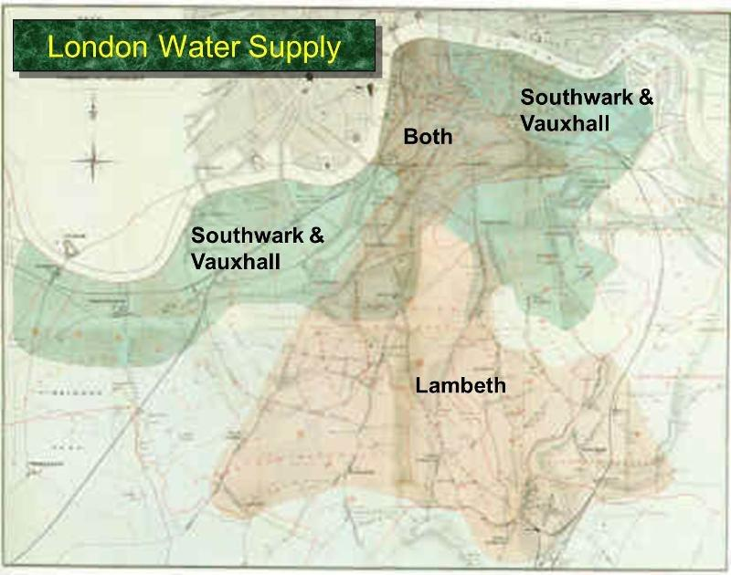
Notes:
Encouraged by what he had learned in Soho, Snow completed a more thorough analysis.
For some time, he had been gathering data on cholera deaths in an area of London that was served by two water companies.
The Lambeth water company drew its water upriver from where sewage was discharged into the River Thames. Its water was relatively clean. But the Southwark and Vauxhall (S&V) company drew its water below the sewage discharge, and thus its supply was contaminated.
The map below shows the areas served by the two companies. Snow honed in on the region where the two service areas overlap.

Slide 19
Comparison
treatment group
control group
does not receive the treatment

Slide 20
Snow’s “Grand Experiment”
“… there is no difference whatever in the houses or the people receiving the supply of the two Water Companies, or in any of the physical conditions with which they are surrounded …”
The two groups were similar except for the treatment.
Notes:
Snow noticed that there was no systematic difference between the people who were supplied by S&V and those supplied by Lambeth.
“Each company supplies both rich and poor, both large houses and small; there is no difference either in the condition or occupation of the persons receiving the water of the different Companies … there is no difference whatever in the houses or the people receiving the supply of the two Water Companies, or in any of the physical conditions with which they are surrounded …”
The only difference was in the water supply, “one group being supplied with water containing the sewage of London, and amongst it, whatever might have come from the cholera patients, the other group having water quite free from impurity.”

Slide 21
Snow’s table
Supply Area | Number of houses | Cholera deaths | Deaths per 10,000 houses
S&V | 40,046 | 1,263 | 315
Lambeth | 26,107 | 98 | 37
Rest of London | 256,423 | 1,422 | 59
Notes:
Confident that he would be able to arrive at a clear conclusion, Snow summarized his data in the table below.
The numbers pointed accusingly at S&V. The death rate from cholera in the S&V houses was almost ten times the rate in the houses supplied by Lambeth.

Slide 22
Key to establishing causality
If the treatment and control groups are similar apart from the treatment, then differences between the outcomes in the two groups can be ascribed to the treatment.
Notes:
In the language developed earlier in the section, you can think of the people in the S&V houses as the treatment group, and those in the Lambeth houses at the control group.
A crucial element in Snow’s analysis was that the people in the two groups were comparable to each other, apart from the treatment.
In order to establish whether it was the water supply that was causing cholera, Snow had to compare two groups that were similar to each other in all but one aspect—their water supply.
Only then would he be able to ascribe the differences in their outcomes to the water supply. If the two groups had been different in some other way as well, it would have been difficult to point the finger at the water supply as the source of the disease.
For example, if the treatment group consisted of factory workers and the control group did not, then differences between the outcomes in the two groups could have been due to the water supply, or to factory work, or both. The final picture would have been much more fuzzy.
Snow’s brilliance lay in identifying two groups that would make his comparison clear. He had set out to establish a causal relation between contaminated water and cholera infection, and to a great extent he succeeded, even though the miasmatists ignored and even ridiculed him.
Of course, Snow did not understand the detailed mechanism by which humans contract cholera. That discovery was made in 1883, when the German scientist Robert Koch isolated the Vibrio cholerae, the bacterium that enters the human small intestine and causes cholera.
In fact the Vibrio cholerae had been identified in 1854 by Filippo Pacini in Italy, just about when Snow was analyzing his data in London. Because of the dominance of the miasmatists in Italy, Pacini’s discovery languished unknown. But by the end of the 1800’s, the miasma brigade was in retreat. Subsequent history has vindicated Pacini and John Snow. Snow’s methods led to the development of the field of epidemiology, which is the study of the spread of diseases.

Slide 23
Confounding
Notes:
In an observational study, if the treatment and control groups differ in ways other than the treatment, it is difficult to make conclusions about causality.
An underlying difference between the two groups (other than the treatment) is called a confounding factor, because it might confound you (that is, mess you up) when you try to reach a conclusion.

Slide 24
Trouble
If the treatment and control groups have systematic differences other than the treatment, then it might be difficult to identify causality.
Such differences are often present in observational studies.
When they lead researchers astray, they are called confounding factors.

Slide 25
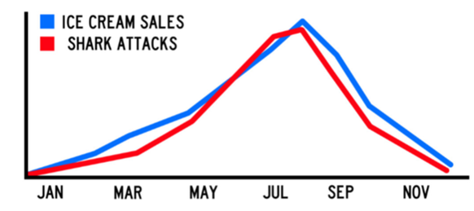
Example of Confounding

Slide 26
Randomize!
If you assign individuals to treatment and control at random, then the two groups are likely to be similar apart from the treatment.
You can account – mathematically – for variability in the assignment.
Randomized Controlled Experiment

Slide 27
Careful ...
Regardless of what the dictionary says,
in probability theory
Random ≠ Haphazard
Notes:
characterized by lack of order or planning, by irregularity, or by randomness; determined by or dependent on chance; aimless.

Slide 28
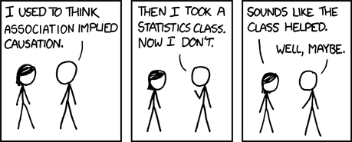
Credit: xkcd

